Slide 1
第14週進度報告
報告者：林廣學
2013 / 05 / 27

Slide 2
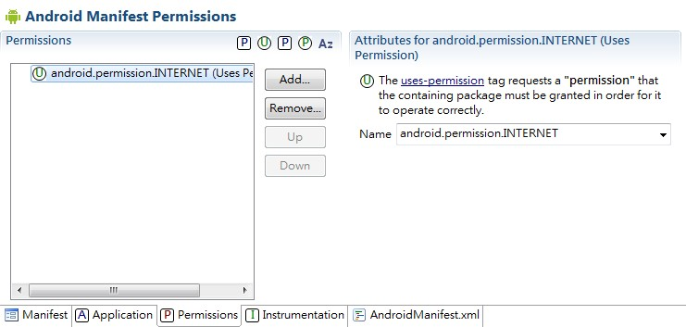
Setting user permission

Slide 3
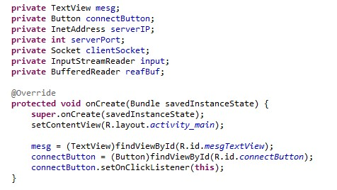
Use package of java.net to Connect to DB
Client 端

Slide 4
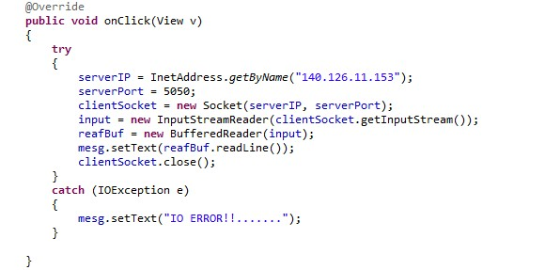
Use package of java.net to Connect to DB

Slide 5
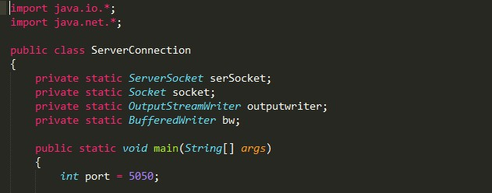
Use package of java.net to Connect to DB
Server端

Slide 6
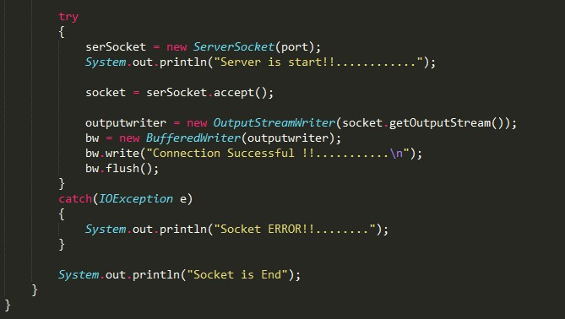
Use package of java.net to Connect to DB

Slide 7
Question
When this APP is execute and I click button, the APP is crash. Why?? Is server stop it?? Or other reason??

Slide 8
Oh!! NO~!!!!
Owing to debug my program so that JDBC and use PHP to connect to DB that may be delay.

Slide 9
Thank you for your listening!!

